Slide 1
Creating Ilfracombe Arts College Banner
By: Ben Renton
BTEC ICT Level 3

Slide 2
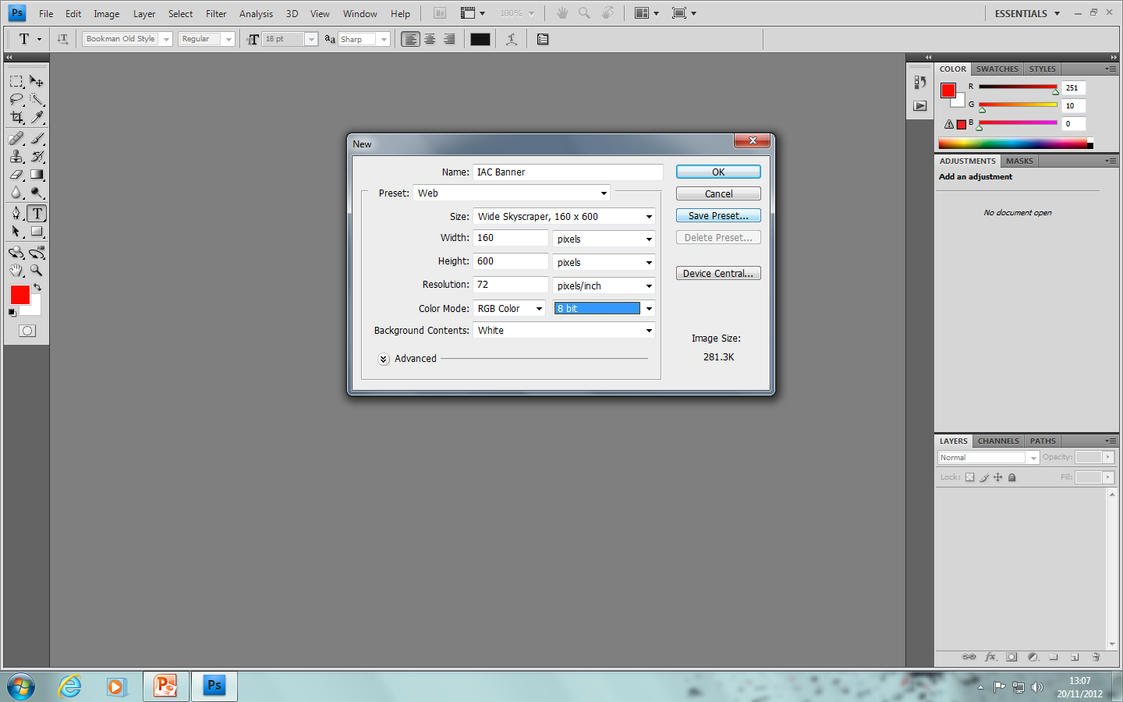
Step 1 – To start creating the banner I needed to open Photoshop CS4. Once on Photoshop I needed to create a new Canvas to work on. To do this I clicked file- New. Then named the layer IAC Banner. I then selected the pre-set as Web skyscraper and the dimensions were 160x600. After all this was selected I clicked OK.

Slide 3
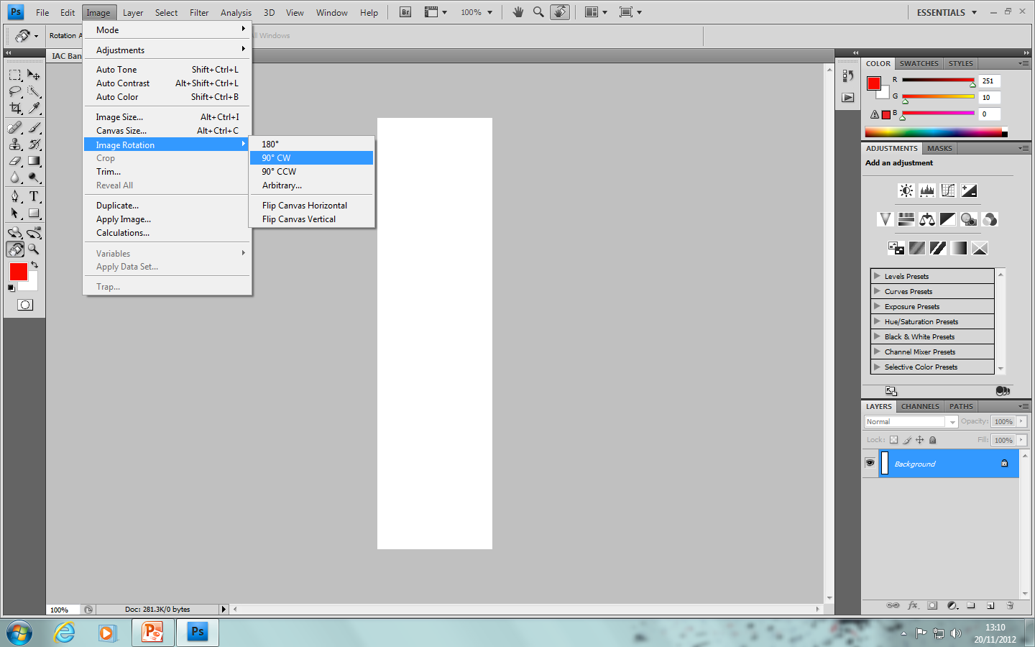
Step 2 – I know needed to rotate the banner base layer 90 degrees CW. This is so the banner is easier to work on and it is the right way round.

Slide 4
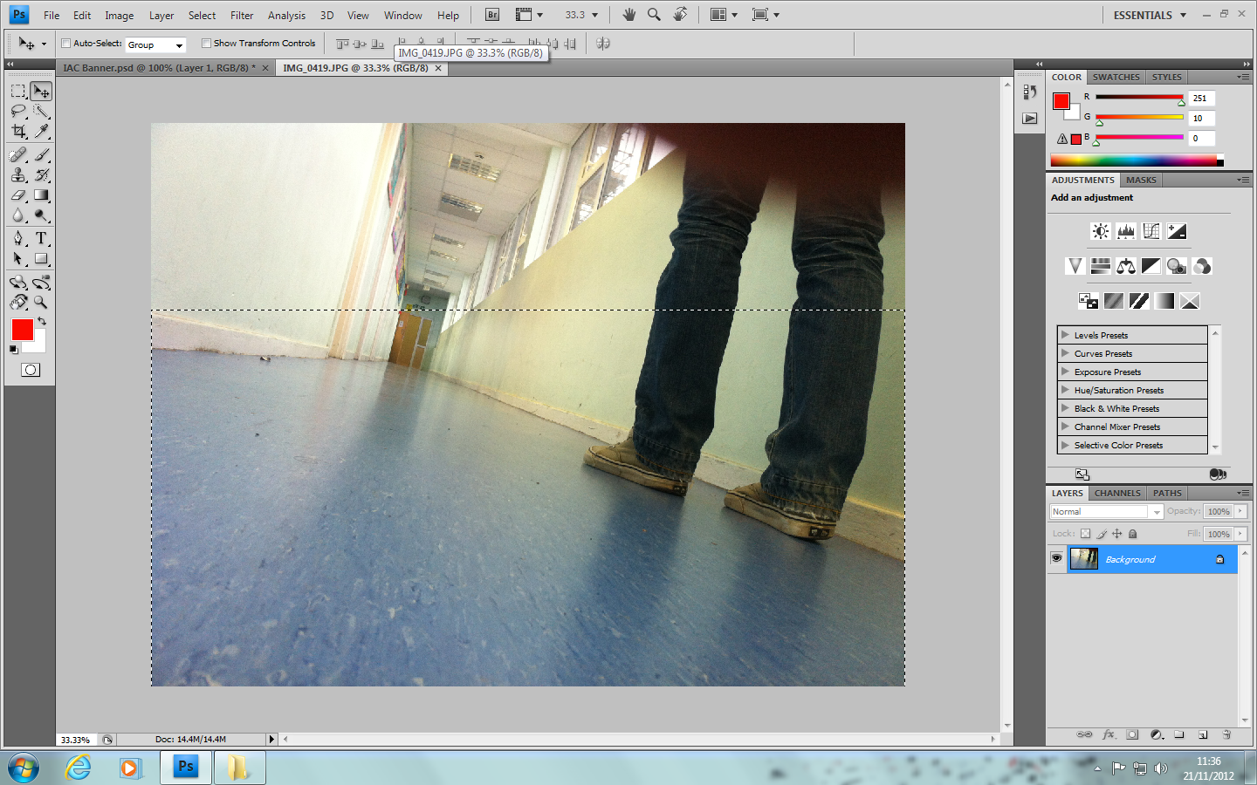
Step 3 – I now opened my image I wanted in the advert. I did this by clicking File-Open. I now used the selection to select a part of the image I wanted on the banner. I then copied the selected part and pasted it on the advert canvas. I then used (Ctrl + T) Free transform to resize the image to the canvas size.

Slide 5
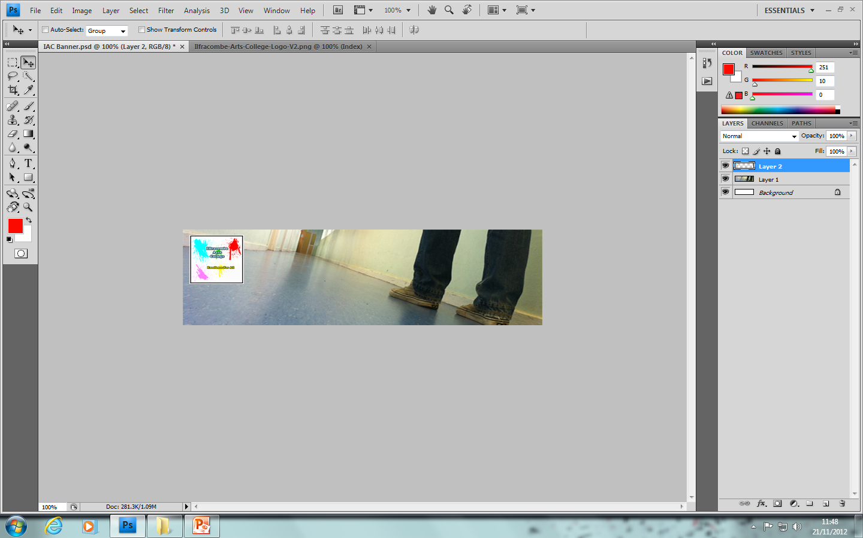
Step 4 – I now followed the same steps to import the logo into the banner the next step is to add text.

Slide 6
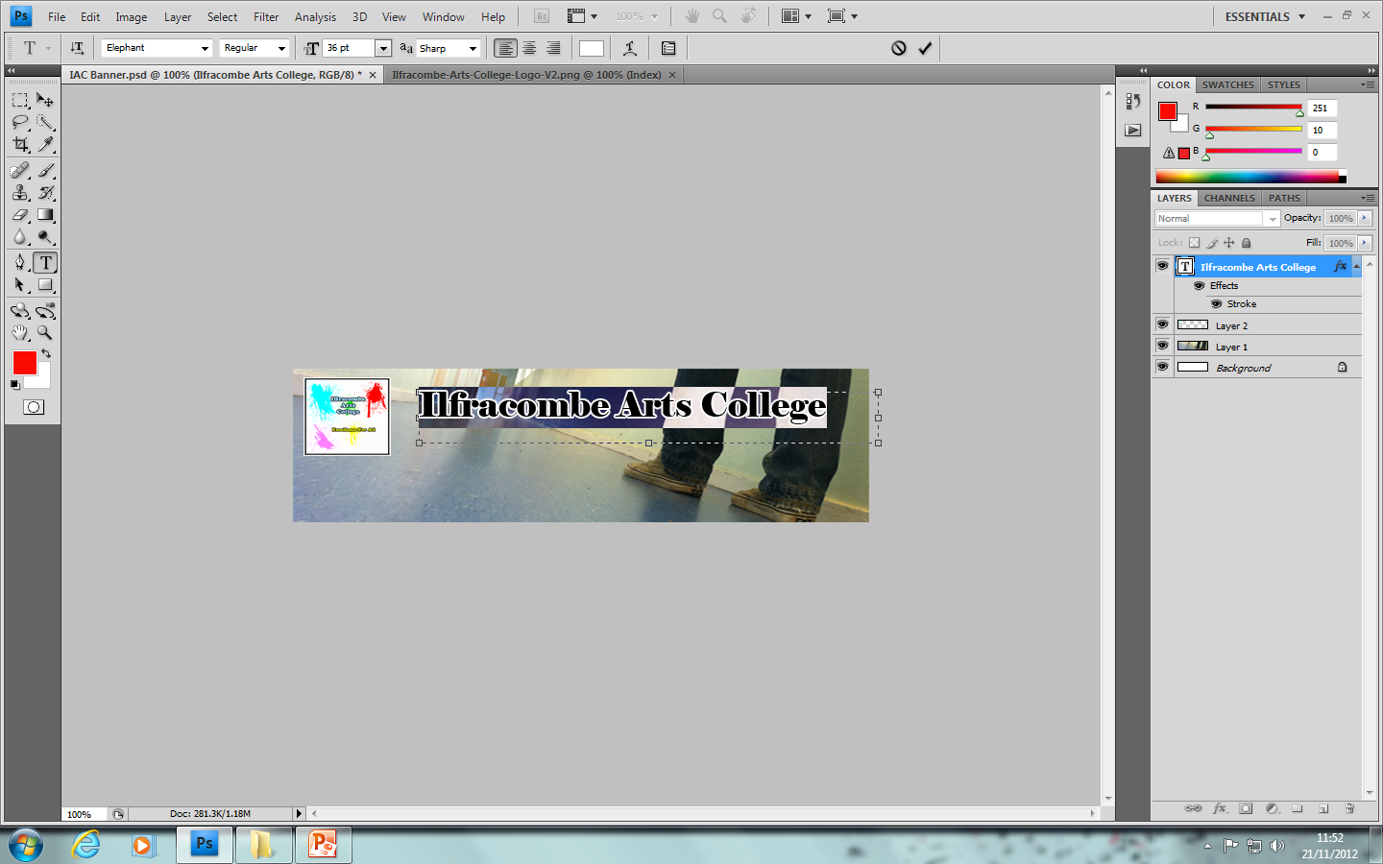
Step 5 – To add the text I selected the text tool to select the area I wanted my text. I then typed Ilfracombe Arts College. To make the text stand out the most I changed the colour to white so it matched the logo and so it stood out compared to its surroundings. I then went into the layer blending options and selected a stroke effect to help it stand out.

Slide 7
Step 6 – Now I have added both texts, I created the second text the same way I did with the previous. Accept with the slogan I coloured it differently. Now it was time to add some animation.

Slide 8
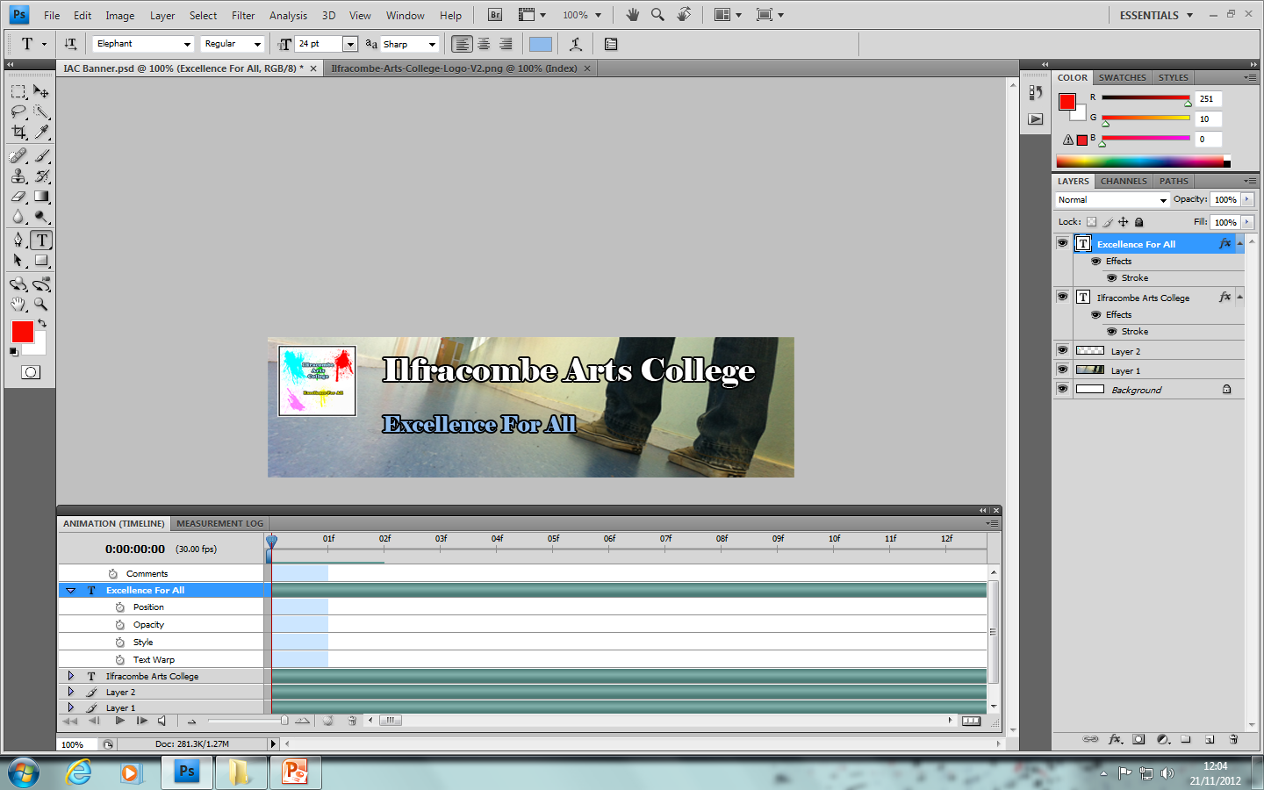
Step 7- To add animation I first needed to open the panel. To do this I clicked Window- Animation and then I had a panel as shown at the bottom.

Slide 9
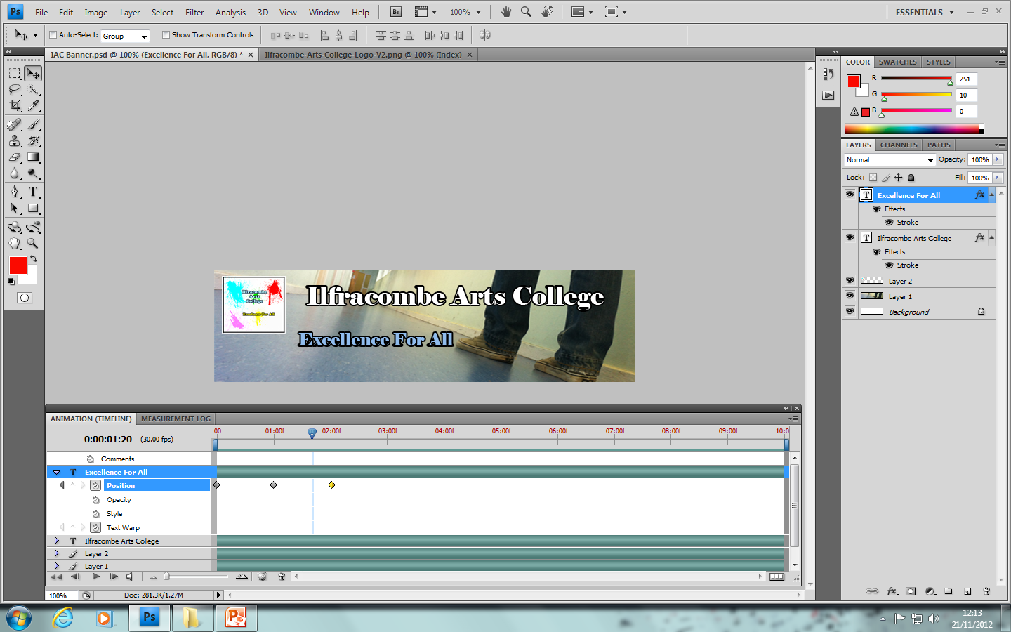
Step 8 – To add animation I selected the text I wanted to animate. I then anchored the positioned by selecting the frame and then positioning the text where I wanted it. I positioned the text in 3 different places so it would run smoothly across 3 frames to get to the final location.

Slide 10
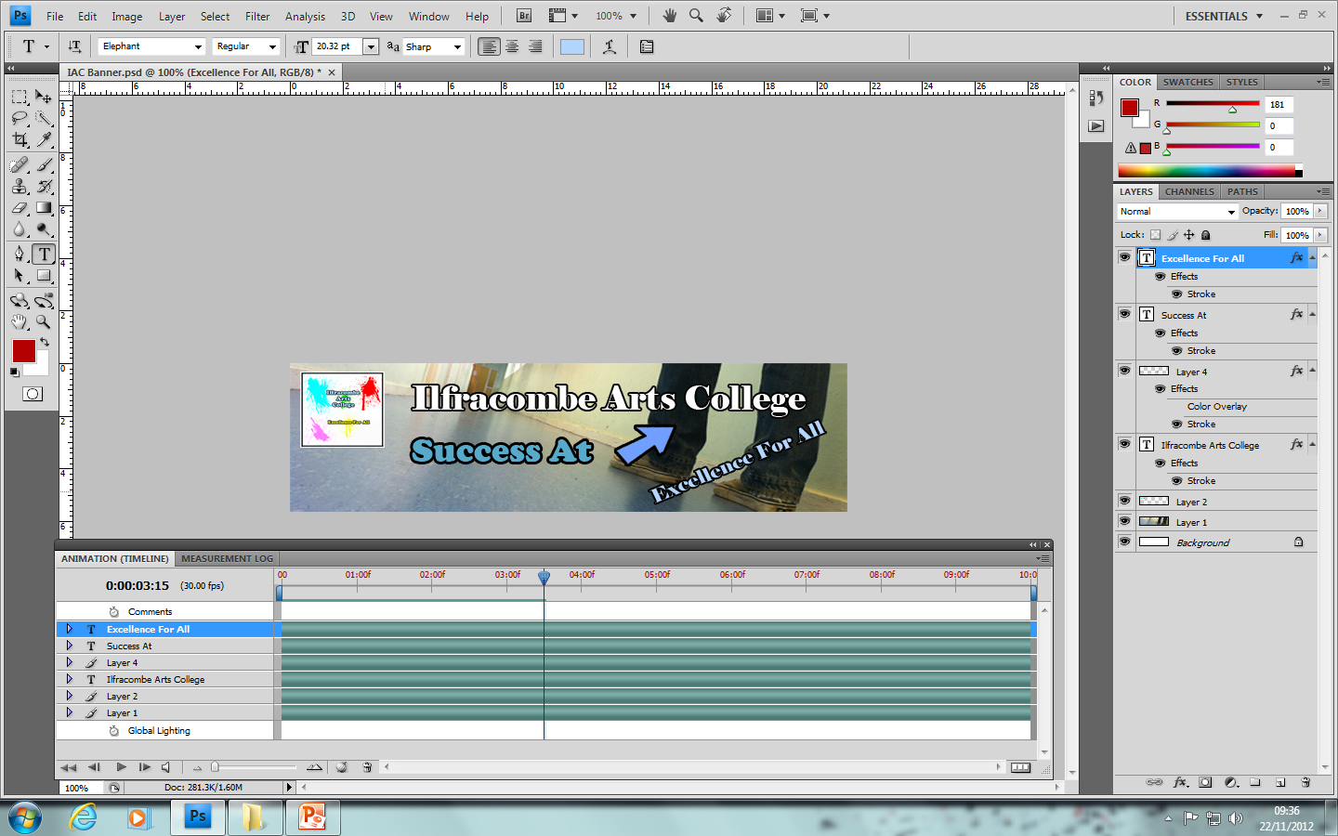
Step 9 – Now all the animations where in place the banner was fully animated and ready. I now uploaded the banner to www.surveymonkey.com to get feedback from users. I asked again a series of 9 questions to get useful feedback for improvement.

Slide 11
Questionnaire Results
Do you find the picture relevant to the information? 2/6 = Yes
Do you find the colours used appealing? 2/6 = Yes
Is the banners animations to long? 5/6 = Yes
Is all the text easily readable? 5/6 = Yes
Do you understand the banner overall? 5/6 = Yes
Do you think it represents the school in a positive way? 4/6 = Yes
What improvement could be made? 2/6 = No Improvement, 3/6 = Info and Text
Is the logo visible clearly? 5/6 = Yes
Overall rating of Banner? Average = 7
These results showed that the information needed to be more relevant to the text. The Animations needed to be shortened ,4 frames = 12 Seconds which is to long. The text needed to meet the schools house style more.

Slide 12
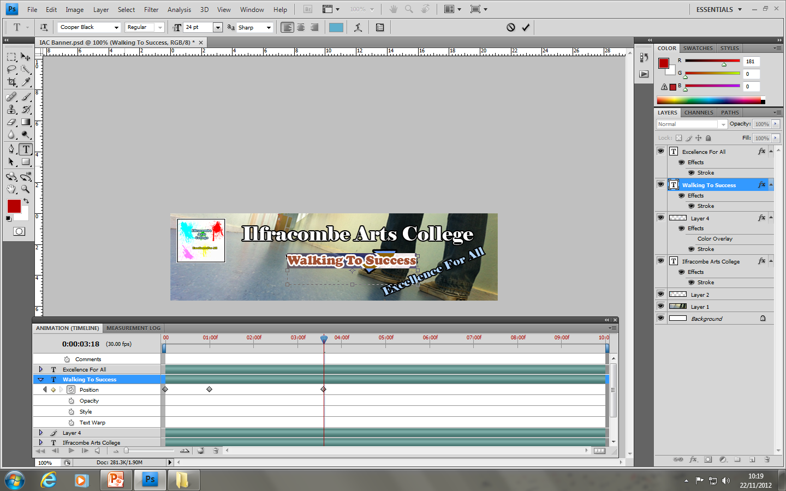
Step 10 (Improvement) – To make the information more relevant I changes the text to Walking to success. This is because the picture doesn't show success, but by changing the info it portrays success. I changed this with the text tool however kept the same animation.

Slide 13
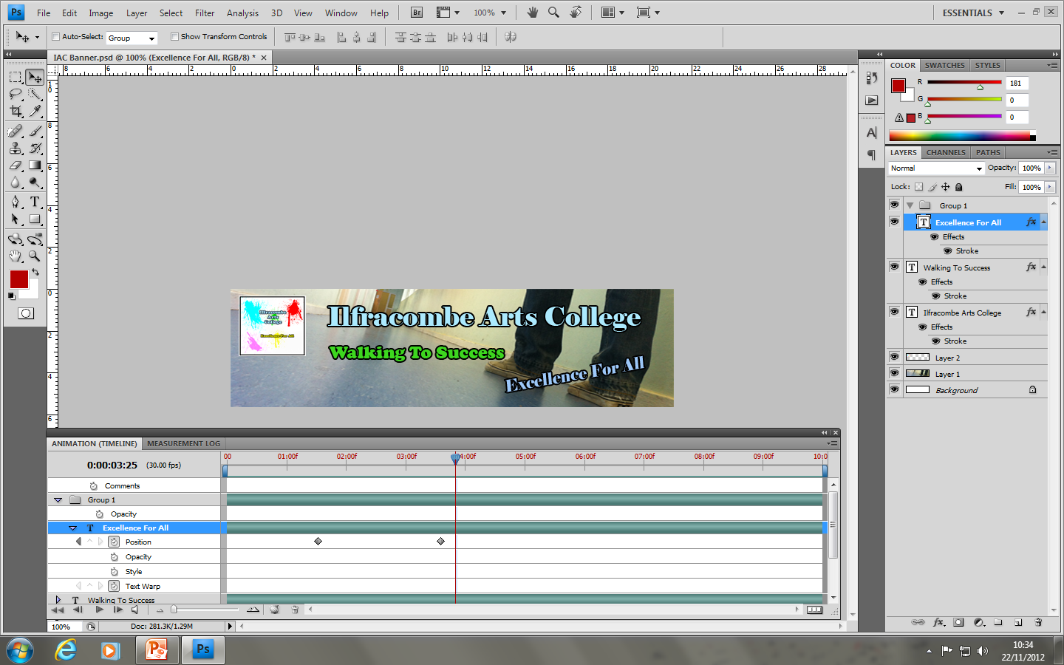
Step 11 – After deleting the arrow because it wasn’t needed anymore I changes most of the writings colour. I changed the colours so they where more relevant to the school house style.

Slide 14
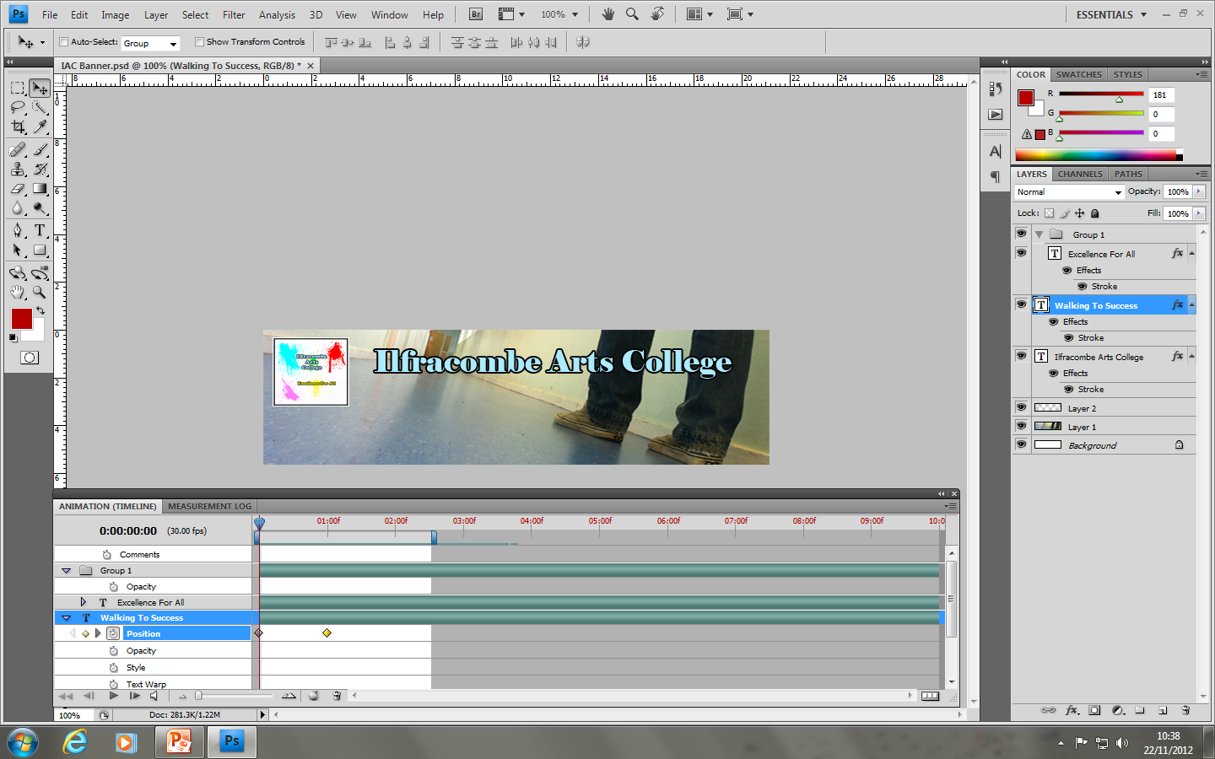
None of the animations where changes just some of the text was rotated etc. The last step was to make the banner shorter to do this I dragged the bar at the top to make the animation restart at 2.5 frames = 7.5 seconds which is 4.5 seconds shorter. I then had to drag the anchors back to the a shorter time.

Slide 15
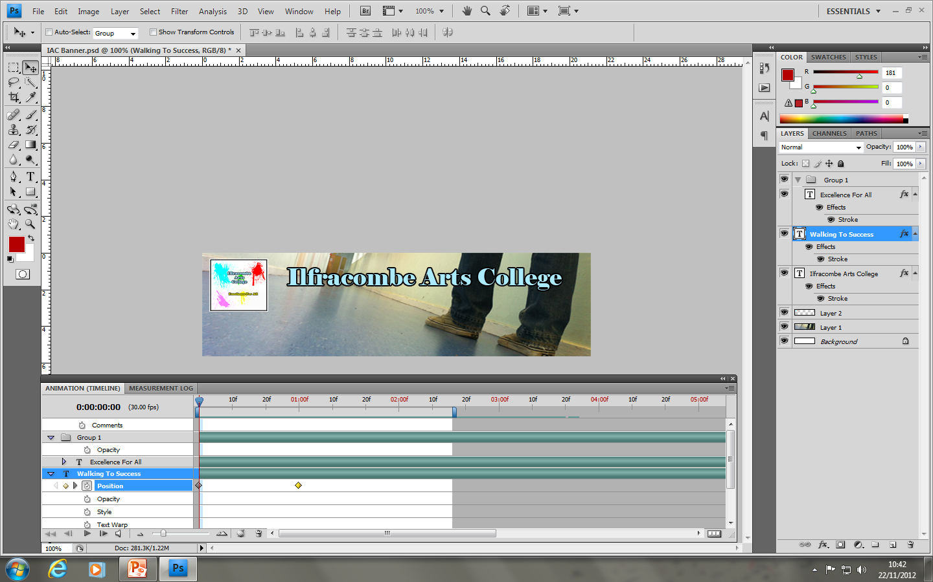
Here is the final version animated in screen shots 0.3 frames per slide. V2

Slide 17
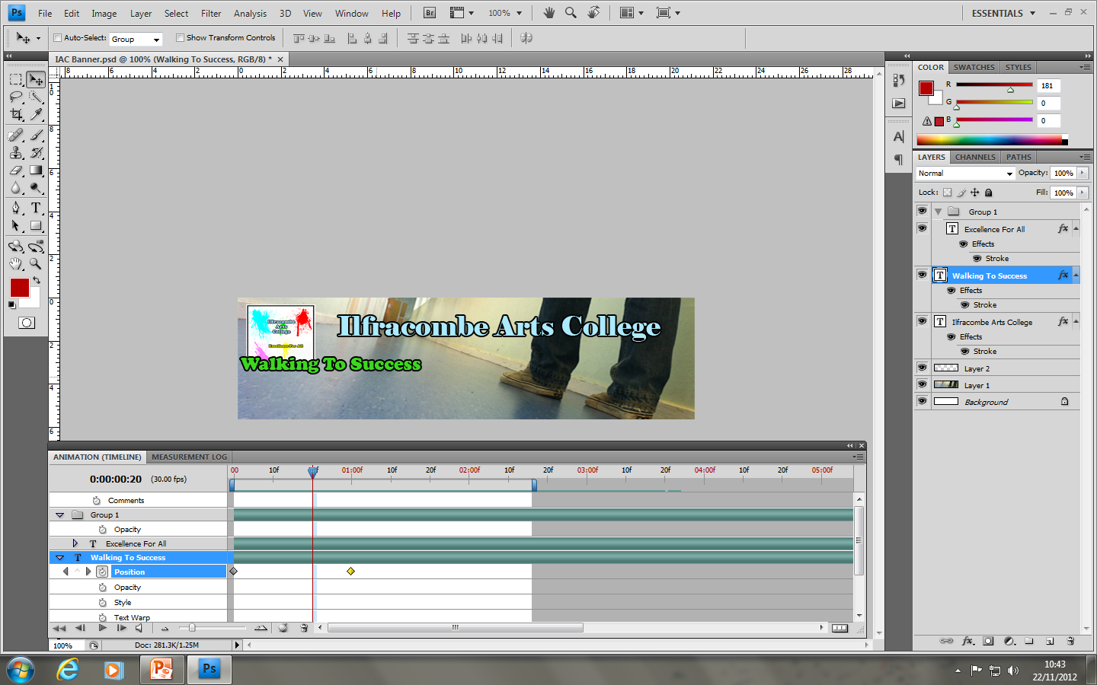

Slide 18
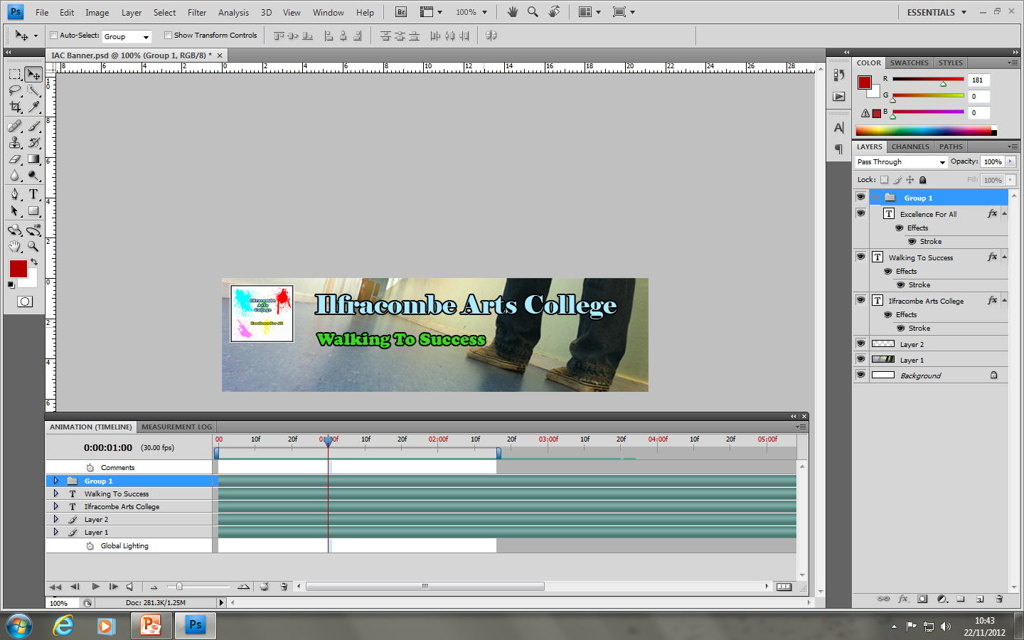

Slide 22
This is the final phase of the banner 2.3 frames. Please note that V1 of the banner would have had the exact same animations it just would have been longer and have different text and different text colour etc.

Slide 23
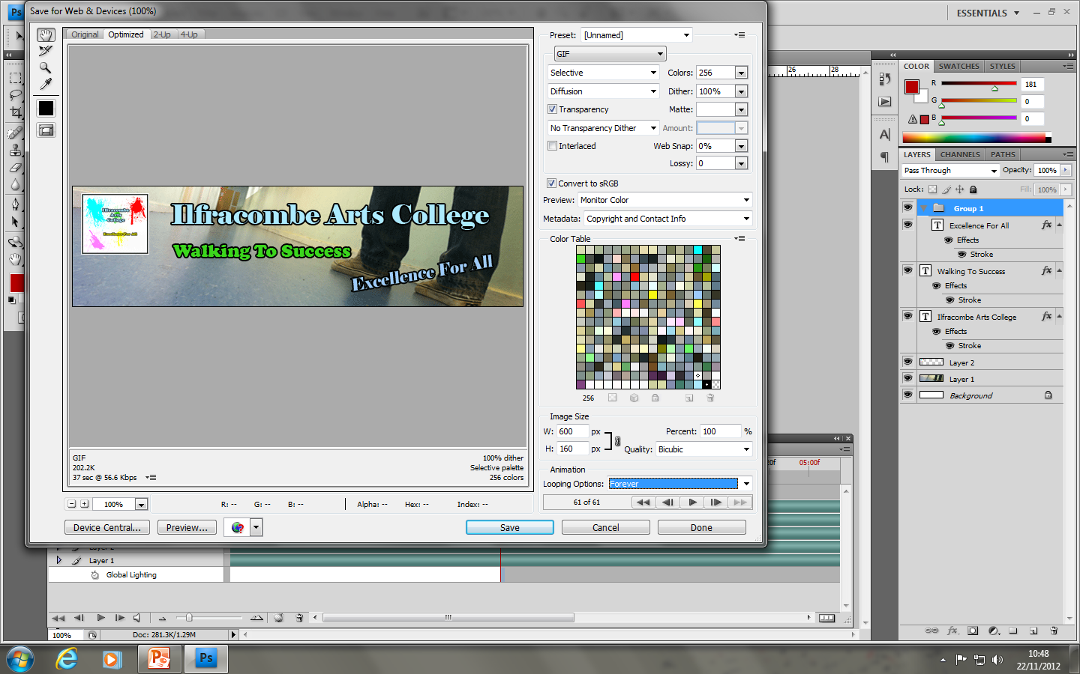
The final step was to save the banner as an animated GIF to do this I clicked file- save for web & devices- selected GIF as pre set and then the looping options as forever. I then finally clicked save.

