Slide 1
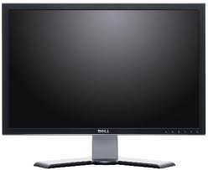
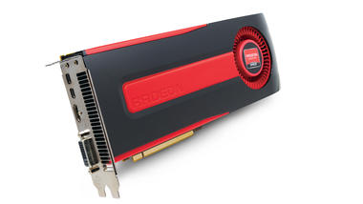
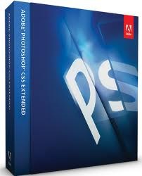
The Hardware And Software Used To Create And Edit Graphic Images
By: Ben Renton

Slide 2
Introduction
During this PowerPoint I will be describing and explaining what each piece of hardware and computer software does to create and edit graphic images. I will be describing the main features for each and why its used to edit graphical images. The following Hardware and Software I will describing, explaining and comparing are:
Hardware
Keyboard and Mouse
Monitor and Graphics Tablet
Digital Camera
Scanners And Printers
Graphics Card
Hard Drive and (SATA)
Software
Photoshop
Microsoft Paint
Paint Shop Pro X5 Ultimate
Gimp
CorelDraw
Expression Design 4

Slide 3
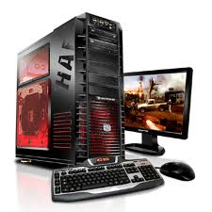
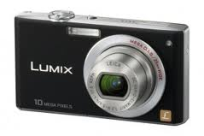
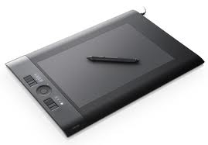
Hardware
Hardware is very important in creating graphic images. Without the hardware even visualizing an image would not be possible. The great thing about hardware nowadays is that you can get components much cheaper because of technology. The advancement in technology has enabled computers to get smaller and much more powerful which overall helps creating and editing graphical images much easier and cheaper.

Slide 4
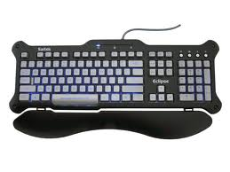
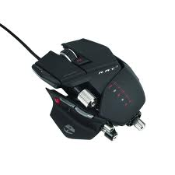
Keyboard And Mouse
The keyboard and mouse are typical inputs that are used to mainly edit graphical images on computer software. The keyboard is originally designed to ergonomically make writing easier. To make typing easier they average keyboard is qwerty it is spelt this way because the first six letters spell QWERTY. The mouse used as a pointing system by transferring information into 2D motion on the monitor.
Modern mice use lasers to transfer the movement to the computer and then to the monitor. Laser mice are much better than ball mice because they can react to movement much more quickly and precisely. Many mice are also wireless which helps with hazards etc. it relies on inferred or radio waves. The mouse is mainly used in editing images, it works well with programs like Photoshop because you are able to manipulate images easily.
The keyboard is not used as much as a mouse in editing and creating graphic images, this is because the keyboard is used to type and not edit images. When creating advertisements or banners which need a text input the keyboard is much more helpful than an on screen keyboard. Overall, the keyboard and mouse is needed during creating and editing graphic images. Without the two input devices editing and creating images would be much harder and more time consuming.

Slide 5
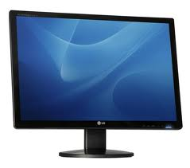
Monitors
A monitor is an electrical device that displays 1000’s of pixels creating images etc. The monitor is mainly designed for computers and that was to display what the computer needs it too, however the monitor can be link to other devices i.e. phone.
There are different sized monitors and different version on monitors like 3D etc. The average monitor size is around 17inch – 22inch. These are the basic monitors that can hold a resolution of around 1200x800 pixels. The bigger the resolution the better quality everything looks it does this because it is displaying more pixels on the screen. However, this is also mainly affected by the graphics card.
In the 70’s and 80’s resolution was much smaller and has improved dramatically over the years without the improvement is resolution many images would look poor quality even though the device that took the image was a much better quality.
Monitors are usually massive when editing graphic images because when viewing images on a small monitor mistakes are much harder to see. But when the images are blown up to build board size mistakes are easy to spot. To prevent this, company's buy large monitors so mistakes are easy to see and editing is much easier.
Monitors are also essential in computer graphics because they are needed to display the image you are creating/editing. Without monitors creating and editing graphic images would be much harder and you would need a TV which cant display resolution as well as monitors, the size of the resolution usually will not full the TV screen this is because they are not really designed for PC’s.

Slide 6
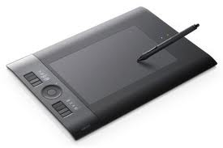
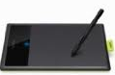
Graphics Tablet
A graphics tablet is an input device that allows you to hand draw images onto the computer. To do this the user will use a pen shaped object to draw onto the surface. The tablet picks up a signal and converts it through the computer onto the monitor.
There are many different types of graphics tablet that can used for generating sound etc. However they are mainly used for drawing.
The graphic tablet is widely used across computer graphics because its easy and simple to use. It allows the user to simply draw adverts etc. Just like you normally would on paper. It also allows you to get your work onto the screen so its editable.
Without the graphics card around creating and editing graphic images would be much harder because user would not be able to input there ideas onto the computer, with a mouse doing this is much harder and much more time consuming.
Compared to a scanner the graphics tablet could be classed as better and worse. They both have advantages and disadvantages, the graphics tablet allows you to convert what your drawing straight to the computer however the scanner allows you to scan your work on to the computer where it can be edited. Overall, I would say that the scanner is more useful in computer graphics because when you draw on paper you are able to use many techniques that the computer can not replicate, and once the image is on the computer you are able to edit it further.

Slide 7
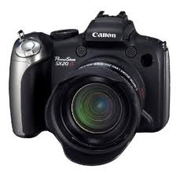
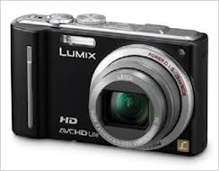
Digital Camera’s
A digital camera takes pictures and record videos using a electronic lens. Cameras take photos of inferred light which we can not see so the camera converts the information onto the display screen.
A digital camera also takes into account image quality measured (Mega pixels) and also the resolution. A resolution 1000x1000 would be 1 million pixels = 1 Mega pixel. The higher quality images also take up more space.
The more expensive cameras that can take images of an extremely high mega pixel these are usually quite expensive, However for convenience digital camera are now found on mobile phones which can also take high quality images.
The advance in technology has also enabled better cameras to be designed and has also affected the price in 2001 a normal 2 Mega pixel camera cost just under £200, now a 14 Mega Pixel camera will cost you around £100. This has allowed cameras to be better and much cheaper.
Digital cameras are extremely helpful in computer graphics especially for photographers who want to create images to sell .They are able to upload the photo they have taken and then edit it for it to be sold. Its also very good for film designers because creating a film consist of a lot of editing on computers and a lot of recording from cameras. So these two work well together.

Slide 8
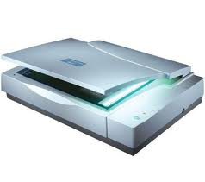
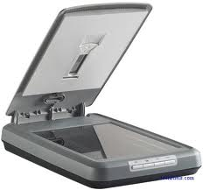
Scanner
A scanner is commonly used to scan and display an image in a way that it is editable on the computer. There are many different types of scanners, some are much more expensive than others because they scan with much better quality.
It scans the image by digitalizing it and dividing the picture up into a tiny grid. Each grid is given an identity either 1 or 0 this tells the computer what to colour each pixel. Then the image it displayed on the monitor where it is editable.
Usually companies that are creating and editing graphic images they would invest in the much better scanner. This is so once the image is scanned it is high quality and looks professional once finished.
An advancement in technology has also allowed scanners to be much better quality. Scanners also work well with printers and are usually connected together, these are called all in one printers. These are able to print and scan and some are also able to read cards, this saves you from putting the files on the computer and then printing them.
Scanners are very important in creating and editing graphic images because they let you scan anything and allow to be edited on the computer and then printed. Without them editing photographs and paintings would be much harder. It also allows us to edit anything we want, that is able to fit on the scanner.

Slide 9
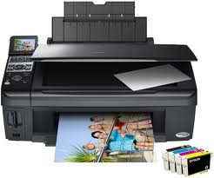
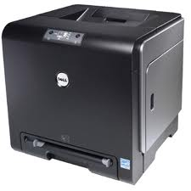
Printers
Printers are most commonly used in household, offices and company estates. These are vital pieces of equipment that is used everyday to quickly display information that we have created on programs like Microsoft word etc.
There are may different types of printers that have different features. Many today are all in one which allow you to scan as well as print. You also able to duplicate a picture etc. without a computer the all in one printer has it built in.
A typical modern printer would be ink jet. This prints by spraying ironized ink on to a piece of paper at around a resolution on 300 dots per inch. This is usually a very good quality image and is great for households.
However when working with graphic images companies go with a different type of printer. They would usually buy printers that print at a much higher resolution. Or if the company was mass producing for example: Newspapers. They would buy printers that are able to print extremely quickly.
Printers are extremely vital in computer graphics without them printing high quality images for adverts and big images which would be on a billboard would be impossible. They would need to be hand drawn/painted meaning the images would be less realistic.

Slide 10
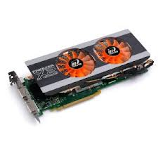
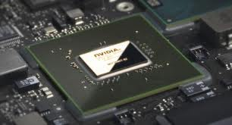
Graphics Card
The graphics card is an input device that generates images onto the display. There are many variations of graphics card i.e. 3D. Some graphics card enable multi monitor which support dual monitors.
They work by connecting to the motherboard and connect to a power source. Some graphics cards use a lot of power when they are working hard and can be overclocked which can damage the graphics card. To overcome this problem of overworking graphics card many modern motherboards have multiple graphics card slots. This allows more graphics card to running at the same time overall improving the efficiency of both graphics cards. However many laptops and smaller computers do not use graphics card because they take up quite a lot of space. These use integrated graphics. Integrated graphics is a much smaller but not a powerful piece of hardware.
The more powerful versions of graphics card allow better graphics and a larger resolution. However the more powerful and efficient graphics are more expensive.
Graphics card also have memory allocated to them they range from 128MB-8GB, the memory allows the graphics card to store the data it is going to display. The more memory allows the graphics card to store better quality images, overall improving imagery.
A graphics card or integrated graphics is essential for a computing when creating and editing graphics images. Without the input of the hardware working with graphic images would be much harder.

Slide 11
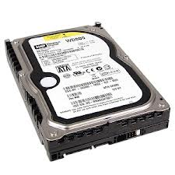
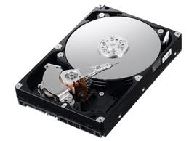
Hard Drive (HDD)
The hard drive is used to store saved data. Usually these store lots of information they range in size from 40GB – 3TB. There are many different types of hardrive some will process data a lot faster than others. These is are called Solid state Hardrive, these will have a lot a less space and range from 40GB – 120GB. These hold much less data because they are able to process data much faster.
A normal hardrive will process data by spinning a platter round extremely fast. It normally will rotate at around 5400 – 7200 Revolutions per minute which is around 20 -40MB/S. This is also dependent on the specs of the computer. SSD Hardrives will process data much faster than this at around 200-500MB/S.
The process speed effects many factors around the PC for example, the start up time on a SATA hardrive on average is around 22 seconds compared to a HDD which is around 40. The breakage time of a HDD is also considerably less than a SSD hardrive.
A HDD and SSD Hardrives are both usually used during computer graphics. This is because the hardrive is used to store most of the data which would take up most of the space and then the SSD hardrive is used to store the data there are currently editing its even used for the operating system so the computer starts up are runs much faster.
Hardrives are extremely useful in computer graphics and enables graphic images to be stored safely while being edited. Without hardrives editing and creating graphic images wouldn’t be possible to do on the computer. It plays a vital role in storing all the information you and your computer needs.
Compared to a memory stick or DVD disk a hardrives are much better this is because they are able to store and transfer data much more quickly. However, a memory stick is much smaller and is much more easily transportable. They cannot hold as much but are much more useful for small PowerPoint's etc. But in computer graphics a hard may be much more useful.

Slide 12
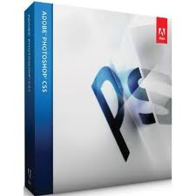
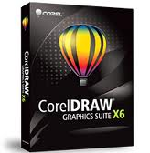
Software
Software is used a lot in computer graphics this is because without software installed onto computers editing and creating graphic images would be impossible. There are many different types of software available and some are more advance than others. Software has given a massive improvement to photography this is because you are able to edit photos after they have been taken in great detail. Before you where only able to take the photo and print it without any modifications.

Slide 13
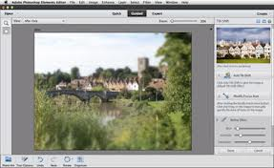
Photoshop
Photoshop is vastly used across the world today. Its used by 1000’s of photographers, game developers, news agents etc. It is one of the most used computer software, this is because of all its features. The software is designed for professionals and isn't good for beginners in computer graphics.
The newest version of Photoshop is CS6 and is worth around £500-600. This is a big investment for small businesses or photographers, instead of Photoshop other software may be a better choice.
Photoshop consists of many features some are the following: UI Redesign, Blur gallery, skin tone and face detection, ACR 7, Video support, oil paint filler, printing UI and JDI’s. These are some of the newest features that have been added into CS6.
Photoshop is extremely vital in many computer graphics. Without Photoshop editing photos and creating graphic images would be much harder. You would also have to use other software which may be not suitable for what your doing or may not have the features that are needed. Photoshop is mainly great for advertisement and photography this is because you are able to go into great detail with editing making sure everything looks perfect. This is why when you are editing images the file is big because it hasn’t been compressed completely. This means you’re able to zoom in without loosing much quality.
Compared to another software like Microsoft Paint, Photoshop is much more advanced and is not made for the same skills group. Paint is mainly the starting point when it comes to creating and editing graphics software. However, Paint does allow skills to develop and allows you to continue onto more advance software leading too Photoshop. Microsoft Paint is also free so it allows you to develop skills for free compared to Photoshop which cost a considerable amount of money and isn't as good at developing early skills.

Slide 14
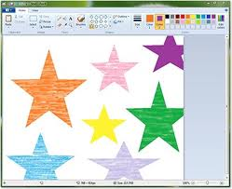
Microsoft Paint
Microsoft paint is great for early skills in editing, they are able develop new skills. The program is installed usually to all Microsoft OS already so the program is free. The program isn't really designed to edit photographs with detail. Its allows the user to develop early knowledge of editing.
Microsoft paint doesn't have many versions that have had added feature. It works very well with touch screen PC/ monitors. This is because you are able to paint with your hands with ease. So it allows you to practice painting and then edit them after to finalize it.
Microsoft paint is not as vital as other software because it doesn't include the main features that are used in editing. It does allow you to develop early skills, however there are many tutorials made for Photoshop that teach you how to use the software effectively. It may be a free software but it isn't helpful for big companies making advertisement or photographers. Also if you where editing with paint it compresses the image before its finish which does save space however it loses a lot of the quality when you zoom in.
Compared to CorelDraw, paint is not as good because it only allows you to develop skills and not really use the useful features in computer graphics. Although CorelDraw costs just over £120 it includes much better features which are helpful in Computer graphics as well as allowing you to practice drawing and develop to advance software. It has many tutorials and each feature is explained on the software. This helps the user understand what each feature does and how to use it.

Slide 15
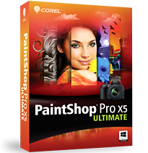
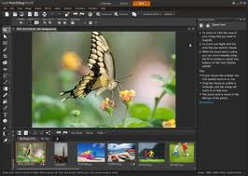
Paint Shop Pro
Paint Shop pro is a much more advanced version of paint. It allows you to use common features that are used in computer graphics. As well as allowing you to practice painting etc. It also allows you to edit the contrast of them etc. This allows you to develop skills with the help provided and tutorials. It costs for the newest version which is X5 Ultimate costs around £70 which is fairly cheap for this type of software.
The software is mainly designed to edit photos rather than create them. You are able to create unique effects on your photos. There website provides lots of tutorials and help. Which allows you to learn about each feature and what it does.
Paint shop pro is used a lot in training during computer graphics. Its not the finalized program that is used much by photographers and company's because it doesn't have the features needed and the detail while editing. However the program is relatively cheap and allows the training to the advanced software.
In comparison to Microsoft paint, Paint Shop Pro is much more advanced. Paint Shop Pro is designed for a medium skill level for those who have learnt the basics of editing. Paint is where many people start off with software for editing and creating images. Paint may be considered better in some cases because its free however is not as useful for editing and creating images because it does not include features needed for editing.

Slide 16
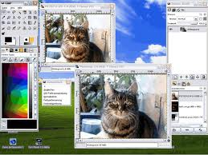
GIMP
GIMP is used by many photographers that work on there own. This is because it’s a free software that has all the features needed to edit photos to a great standard. It also allows photographers to not spend lots of money on software like Photoshop because GIMP has many features the same as Photoshop.
The layout of the software is easy to follow and also there website provides a lot of help and tutorials. There are many example on the website and online of pictures before and after they have been edited. These examples support that simple pictures can be changes dramatically into professional images.
GIMP is mainly used by small companies or photographers that don’t have a large budget to spend on editing software. It also may be the last training phase of an editor because it allows the last skills to finally develop. GIMP Overall is a great piece of software and doesn't cost anything so it has a major advantage over other software.
Compared to CorelDraw GIMP is better because its free and CorelDraw costs. However, CorelDraw costs because it provides much better help and tutorials. CorelDraw also has more features and a easy layout to follow which makes up for the cost. Overall, both pieces of software individually preform very well, but for people who have just started with editing CorelDraw would be the better choice because it provides much better tutorials and help.

Slide 17
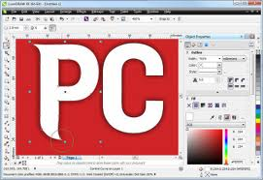
CorelDraw
CorelDraw is a vector graphic editor the newest version is X6 and was originally designed in 1989, the program is similar to GIMP and costs around £140 for the newest version. There are over 10,000 Clip art images also included with CorelDraw.
CorelDraw has a very easy to follow layout and is great for intermediate editor's. As an averaged priced software CorelDraw allows smaller business and many photographers to invest money that will be worth it in the long run.
CorelDraw is very well priced because of the unique features it includes. In the newest version X6 it includes many new tools i.e. Twirl, Attract and repel tools. There are many other tools included within CorelDraw, however these new features have shown a lot of interest from users.
Compared to Expression Design 4 the newest version of CorelDraw is more expensive. Also because Expression Design is created by Microsoft they have a very good reputation for tutorials and help. Microsoft also like to keep everything simple and have stuck with this when making Expression design. The layout of keeping everything simple allows skills to develop faster and much more efficient working. However, CorelDraw is updated much more often meaning problems are fixed much more quickly.

Slide 18
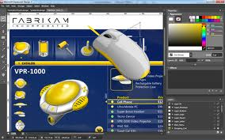
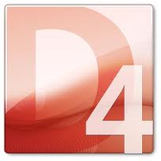
Expression Design 4
Microsoft Expression Design 4 is based more on web graphics compared to print graphics so is not as useful for photographers however is much better for web designers and advertisement. Microsoft is known well for its simplicity and Expression Design has a simple panel which allows you to find everything quickly meaning more efficient working.
The stable version was released in 2007 and is worth still around £100. This shows how powerful the software is and many people still use it for web design etc. The software however is not updated often and may take a long time for bugs and new features to be released.
Without expression design making graphics for the web would be extremely hard not many software that are low costing cover for both print and online graphics. These are classified as two different graphics because online graphics need to be compressed well for a small file size and print graphics need to be high quality.
In comparison to GIMP expression design costs but has much more help and advice and is known to be much more simpler. Both software are mainly for website graphics and both are very efficient, but overall Microsoft Expression Design is better because of the simplicity and low standing price which small companies are still able to invest in without problem.

Slide 19
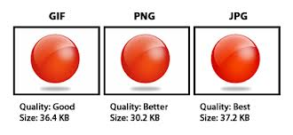
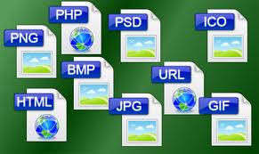
File Types
There are many different file types used in graphics, they are all compressed in different ways which give them different sizes and properties. The place where each image starts is as a RAW file. These files are huge in size but when zoomed into the image it doesn't lose quality. These are used usually by digital photographers when a image is taken for a camera it is transported straight onto the computer where it is edited and compressed into a certain file type. For example if the image was being created for a online advertisement the image would be compressed into a JPEG because this is a very small file so its loaded up quickly. The file dose lose quality when zoomed in but usually on advertisement viewers don’t zoom into the pictures.

Slide 20
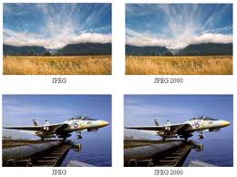
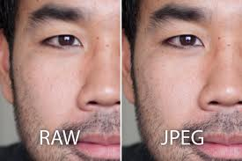
JPEG
JPEG Is used mostly on the web because it is a very compressed. The file size is usually very small so is loaded up quickly when viewed. It has a very efficient quality for its size. Which overall gives images a good amount of detail as well as loading very quickly. The loss of compression from a RAW file is 10:1 which is a huge decrease in file size but not as much in quality.
The file type is most commonly used on the internet and many digital devices. Without JPEG many pictures on the internet wouldn’t load up as fast or may even be much worse quality.
Comparing JPEG to GIF these are both used usually on the internet and advertisement. GIF has a small difference in file size but however JPEG is much better quality. This is due to how the image is compressed. Also GIF is used for website banners in advertisement so the image quality is not needed as much because the image is only viewed for a short period of time. JPEG is needed for standard quality and may be viewed for some time. This can be the case on auction websites like Ebay because images of items are viewed in detail and the files used have to be small and of an ok quality.
JPEG Is different to the other file types because it compresses RAW data into a very small size and still keeps a very good amount of quality making it one of the most used file types for the internet.

Slide 21
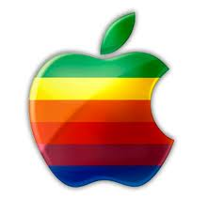
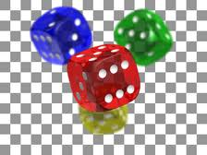
PNG
PNG (Portable network graphics) Is also use across the web because of its small file size. The main feature of the file type is it saves a transparent background. It was created in response of the limitations of GIF. It has improved colour support and an 8-bit transparency channel. PNG is also very popular with programs all though the file Is not used much in professional graphics its used a lot on the internet most operating systems. Mac OS saves screenshots as PNG showing that it’s a very well known file type.
Comparing PNG to GIF, PNG is much more advance and was originally designed to overcome the disadvantages of GIF. The file size is smaller than GIF and the image quality is better. It is also widely used on the internet and by operating systems like MAC OS. It is also a much newer file type so there are less problems with converting and many more programs work better with it.
PNG is also a compressed RAW file and compresses at about 90%. This loses a massive amount of data and loses most of the quality but if the image is only glanced at PNG is great for website photos etc.
Without PNG, GIF would still be a commonly used file type and still include have disadvantages that may have not been fixed. Online images would load up slower and may be not as good quality.

Slide 22
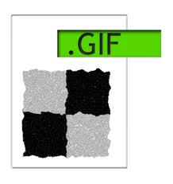
GIF
GIF uses up to 256 index colours and is great for online small images that include text for example website buttons like ‘homepage’ etc. These file types can also be saved as animated GIF’s unlike PNG. The pixels on a GIF file type must also be fully transparent on opaque and cannot be faded like the PNG.
If the file type is an animated GIF it is used on the internet for basic animations and the pixels are able to blend In with other colours. The file format is perfect for a time lapping animation or web banners.
The GIF file is used for a verity of different images on the web. However, during professional graphics this file type would not be used because it loses a lot of quality when it is compressed and loses quality but It does keep a lot of quality in text which makes it easy to see and read making it great for website buttons etc.
Compared to JPEG, GIF is used for smaller images and has a smaller file size, but JPEG is used for much bigger images and text quality is kept the same making it commonly used on website images. JPEG doesn't compress as much as GIF so it keeps a better quality overall. However, this does mean that GIF is smaller and will load more quickly on demand.
Overall, GIF is one of the most commonly used online file types. It used across many well known operating systems and used by many computer software. Without them small graphics like homepage buttons would be harder to create with other file types.

Slide 23
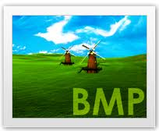
BMP
BMP (Bit map) is largely found in paint and has a large file size. The image loses quite a lot of quality all though is still has a large file size. This file format has a unique feature and that is that each individual pixel can have a different depth meaning the quality looks much better from further away. BMP is not used much on the internet but is mainly used by programs that are used to create graphics instead of editing them.
Compared to PNG, BMP is much bigger and doesn't compress the RAW file as well. However BMP is able to give each pixel a different colour depth meaning the file is much easier to edit and create. BMP is also used a lot by Microsoft Paint because it doesn't take long to compress.

Slide 24
Vector And Raster Images
Raster
Raster images are composed pixels created from various colours, which together form an image. Each pixel has a different depth .
Vector are not created by pixels. They are created by lines/paths and can be scaled very large without losing quality. They must be either straight or curved
Raster graphics also once enlarged so is each pixel so it loses quality. Vector on the other hand can be business card to billboard sized without losing quality. This is why many logos are created from vector graphics because the logo can be enlarged onto billboards etc. without losing quality.
Vector graphics are typically created by using illustrators (adobe illustrator) they are created mathematically and have a direction as well as scale. Raster graphics are created by a grid method and using pixels and are created by programs like Photoshop. These pictures demonstrate well the quality of Raster and vector.
Vector

Slide 25
Bibliography
http://en.wikipedia.org/wiki/Computer_keyboard
http://en.wikipedia.org/wiki/Mouse
http://www.howstuffworks.com/mouse2.htm
http://www.webopedia.com/TERM/M/mouse.html
http://www.webopedia.com/TERM/M/monitor.html
http://www.howstuffworks.com/monitor.htm
http://www.ehow.com/info_10018652_things-graphics-tablet.html
http://computer.howstuffworks.com/3dgraphics10.htm
http://www.digitalcameraworld.com/
http://electronics.howstuffworks.com/cameras-photography/digital/digital-camera.htm
http://www.astropix.com/HTML/I_ASTROP/HOW.HTM
http://computer.howstuffworks.com/scanner.htm
http://support.ricoh.com/bb_v1oi/pub_e/oi_view/0001033/0001033303/view/scanner/unv/0171.htm
http://www.scantips.com/chap3.html
http://www.streetdirectory.com/travel_guide/118500/printers/key_features_in_a_computer_printer.html
http://computer.howstuffworks.com/inkjet-printer.htm
http://www.youtube.com/watch?v=hEj0SsCstIM
All these websites where visited on 16/10/12
18/10/12
(Continued)

Slide 26
Bibliography (Continued)
19/10/12
http://computer.howstuffworks.com/graphics-card.htm
http://www.ehow.com/how-does_4568341_video-card-work.html
http://www.youtube.com/watch?v=j21IDISDub4
http://www.wisegeek.org/what-is-a-graphics-card.htm
http://www.which.co.uk/technology/computing/reviews/hard-drives/page/features-explained/
http://computer.howstuffworks.com/hard-disk.htm
http://www.pcworld.com/article/18693/article.html
http://arstechnica.com/information-technology/2012/06/inside-the-ssd-revolution-how-solid-state-disks-really-work/
http://computer.howstuffworks.com/solid-state-drive.htm
http://www.dpreview.com/articles/2601746315/photoshop-cs6-beta-new-features-for-photographers
http://digital-photography-school.com/23-cool-new-features-in-adobe-photoshop-cs6
http://www.adobe.com/products/photoshop.edu.html
http://www.youtube.com/playlist?list=PL33651E15DCC4E143
http://www.microsoft.com/resources/documentation/windows/xp/all/proddocs/en-us/mspaint_overview.mspx?mfr=true
http://www.ehow.com/list_6907311_microsoft-paint-features.html
http://techtips.salon.com/microsoft-paint-2510.html
http://www.amazon.co.uk/Corel-Paint-Shop-Pro-8/dp/B00009450H
http://www.corel.com/corel/product/index.jsp?pid=prod4900069&cid=catalog3550067&segid=8100006&storeKey=gb&languageCode=en
http://www.unesco.org/webworld/infotraining/psp1.html
(Continued)
20/10/12

Slide 27
Bibliography (Continued 2)
http://www.gimp.org/features/
http://www.gimp.org/about/introduction.html
http://gimp.lisanet.de/Website/News/News.html
http://www.gimp.org/about/
http://www.amazon.co.uk/CorelDRAW-Graphics-Suite-X6-PC/dp/B007F7ZZWE
http://www.epiloglaser.co.uk/tl_corelx6_features.htm
http://www.youtube.com/watch?v=pnfq3VTfI3s
http://www.microsoft.com/expression/products/Design_Overview.aspx
http://en.wikipedia.org/wiki/Microsoft_Expression_Design
http://illustrator-software-review.toptenreviews.com/expression-design-review.html
http://www.jpeg.org/
http://www.webopedia.com/TERM/J/JPEG.html
http://www.fileinfo.com/extension/jpg
http://www.cambridgeincolour.com/tutorials/RAW-file-format.htm
http://www.fileinfo.com/extension/raw
http://www.fileinfo.com/extension/png
http://www.mywebsite.force9.co.uk/png/
http://www.fileformat.info/format/png/corion.htm
http://www.fileinfo.com/extension/gif
http://www.fileformat.info/format/gif/egff.htm
http://filext.com/file-extension/GIF
21/10/12
22/10/12 (Continued On To Next Page
(Continued)

Slide 28
Bibliography (Continued 3)
http://www.fileformat.info/format/bmp/egff.htm
http://www.fileinfo.com/extension/bmp
http://www.daeja.com/products/bitmap.asp
http://www.sketchpad.net/basics1.htm
http://www.illustratortips.com/index.php/Instruction/Beginner-Tips/vector-vs-raster.html
http://grass.osgeo.org/gdp/grass5tutor/HTML_en/c1479.html
https://geodata.ethz.ch/geovite/tutorials/L2GeodataStructuresAndDataModels/en/html/unit_u4VecVsRas.html
http://en.wikipedia.org/wiki/Comparison_of_raster_to_vector_conversion_software
http://www.lashf.com/page/basic/vector_vs_bitmap
https://www.google.co.uk/search?hl=en&noj=1&site=webhp&spell=1&q=vector+compare+raster&sa=X&ei=khCHUIGLHoHN0QXRyYH4Aw&ved=0CB8QBSgA&biw=1600&bih=809
http://bgis.sanbi.org/gis-primer/page_19.htm
All images where copied from (http://www.google.com/imghp) I take no credit from any images used during this presentation.

