Slide 1
Creating Ilfracombe Arts College Advert.
BTEC Level 3 ICT
By: Ben Renton

Slide 2
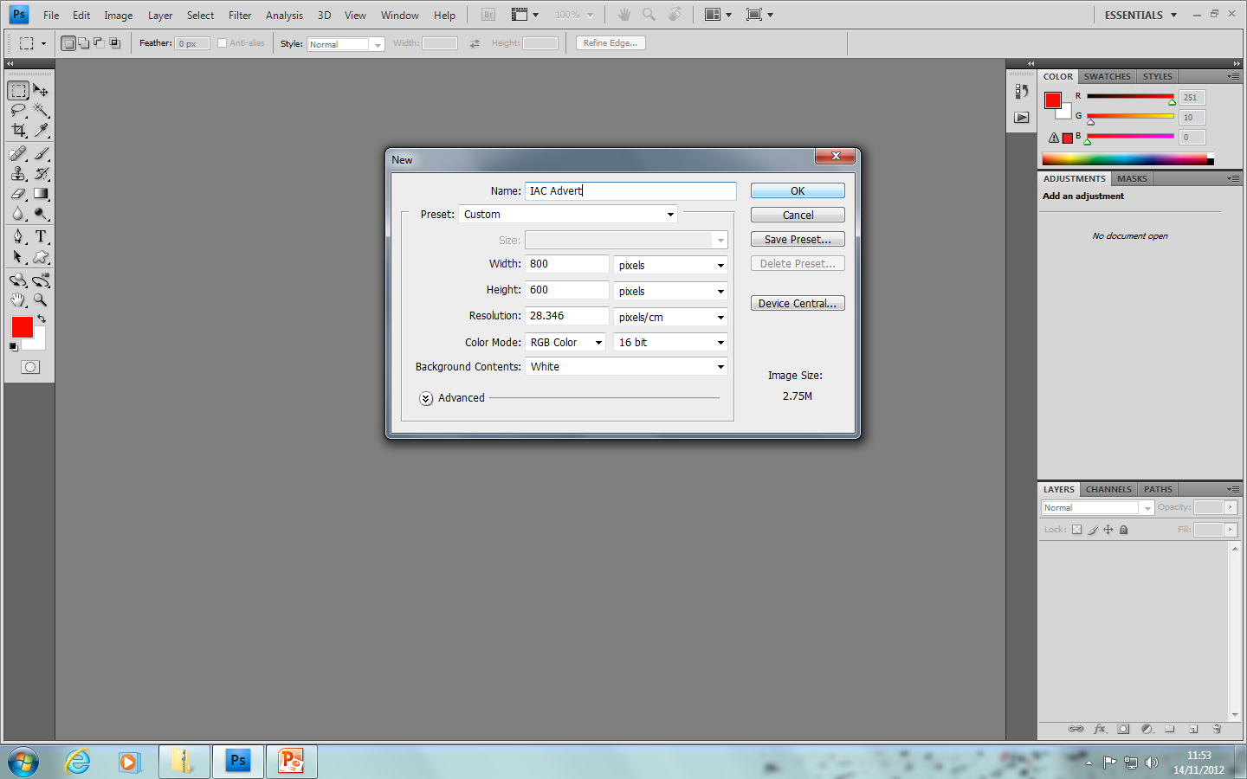
To create the advert I was again going to use Photoshop because of the tools and features it provides. To start creating the advert I needed a base layer to work off. Once Photoshop was opened I clicked file new and then selected the dimensions of the advert which was 800x600 pixels. I then clicked OK.

Slide 3
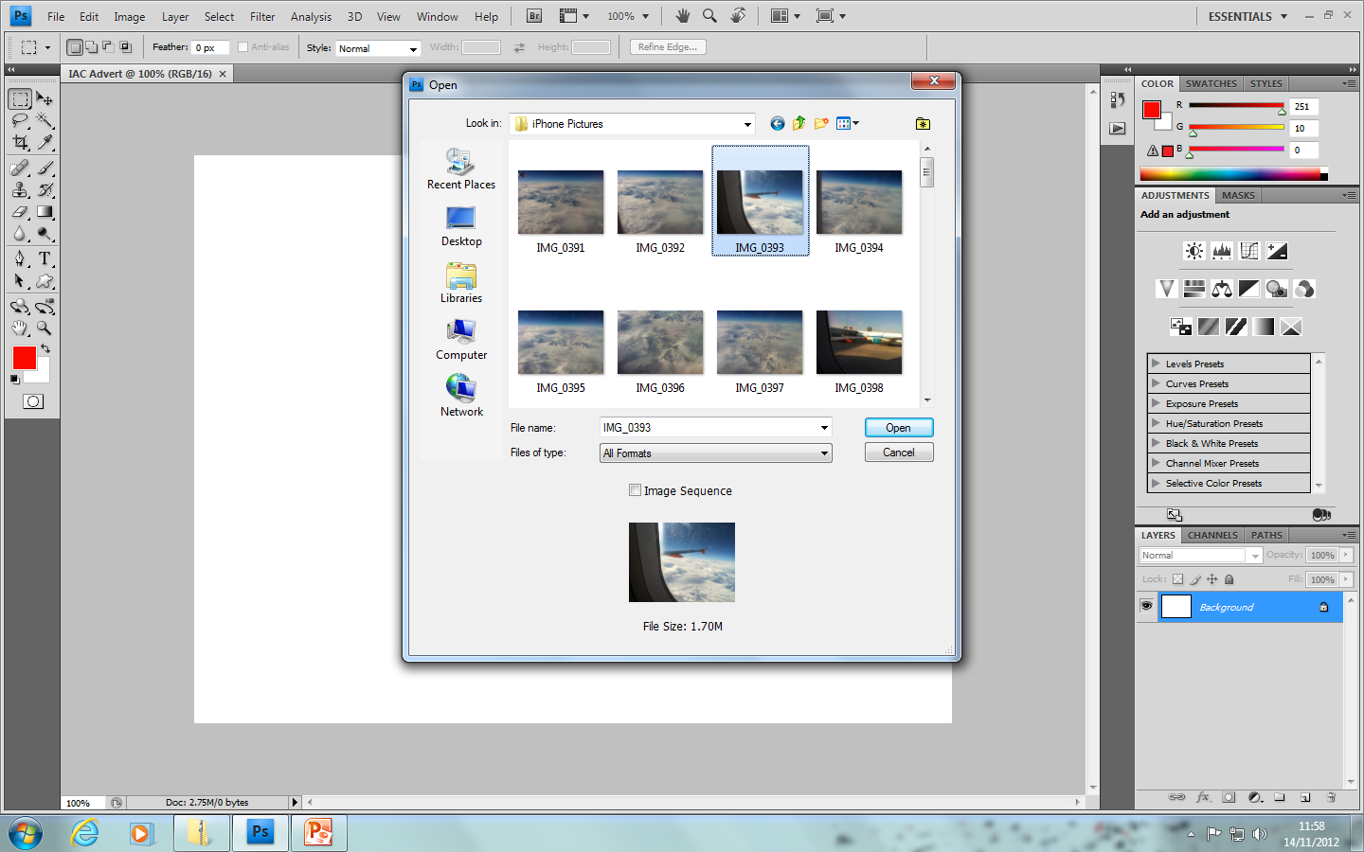
I now needed to import my first image to do this I clicked file open and then found the directory of the pictures I wanted. After I found the file I clicked Open.

Slide 4
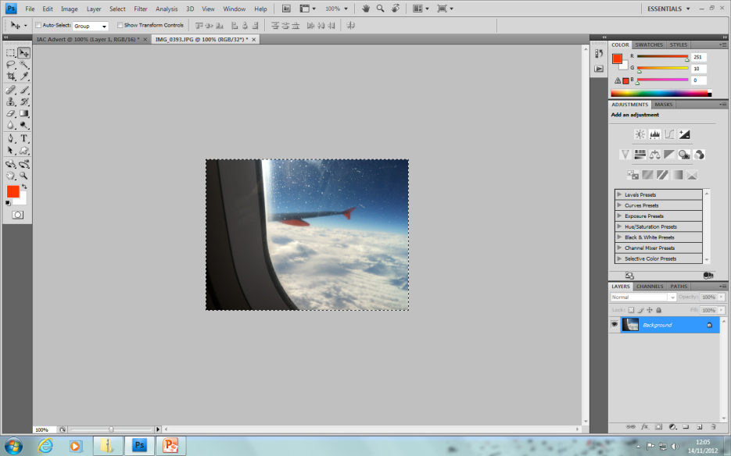
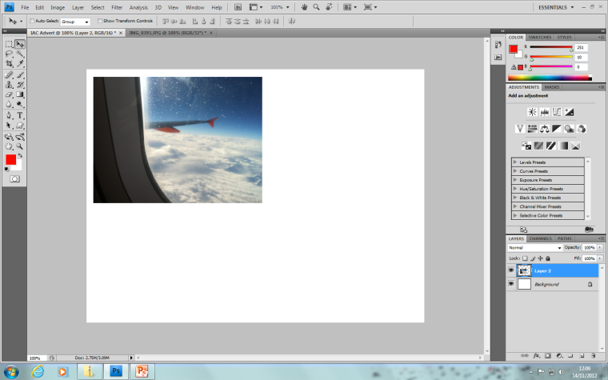
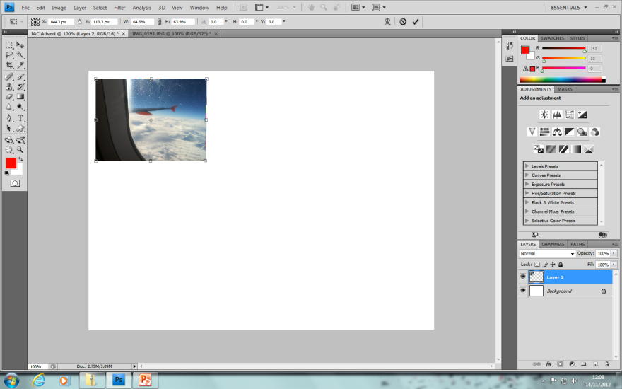
Now the first image is opened I used the selection tool to fully select the image. I Then dragged the image over onto the background layer. The image was too big for the advert so I used free transform (Ctrl+T) to resize the image.

Slide 5
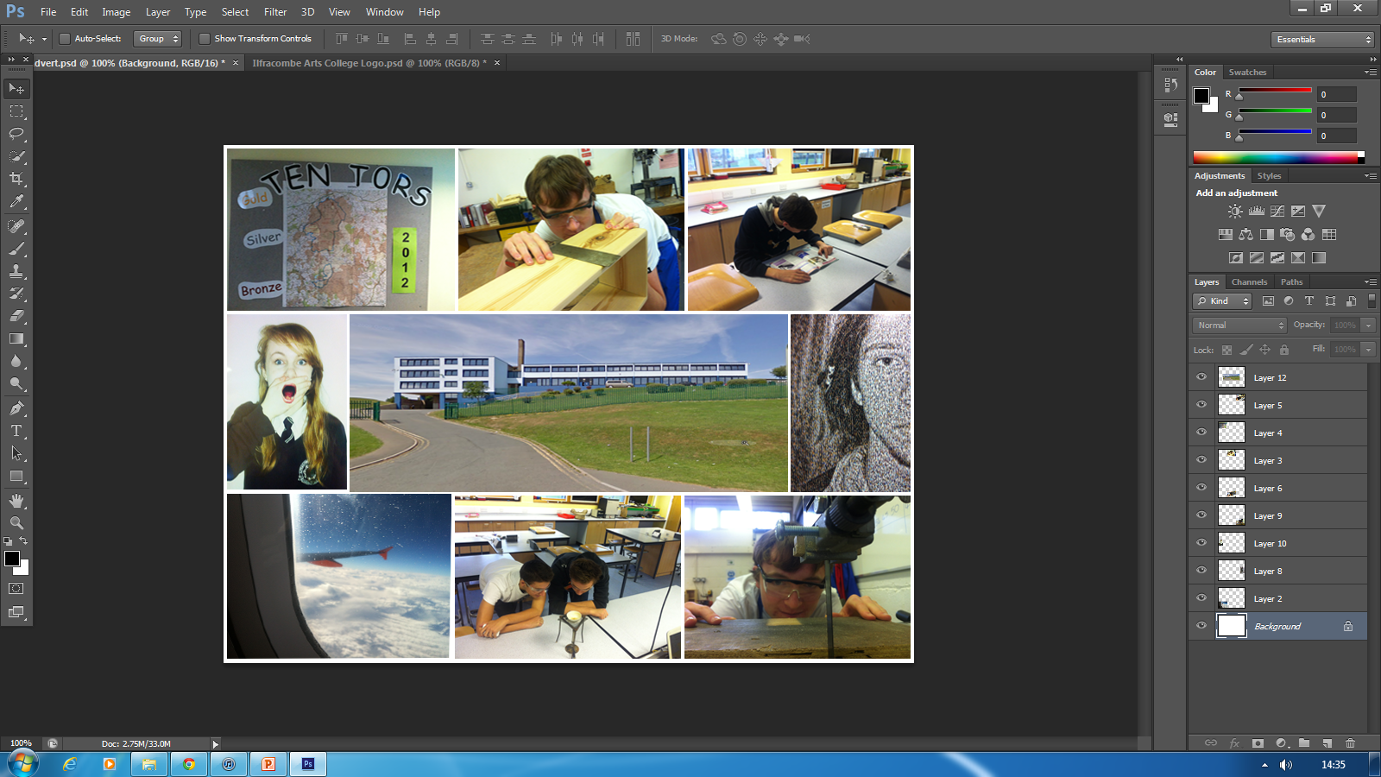
I now added all the pictures necessary for the advert and used free transform on each, I then positioned them in the correct place.

Slide 6
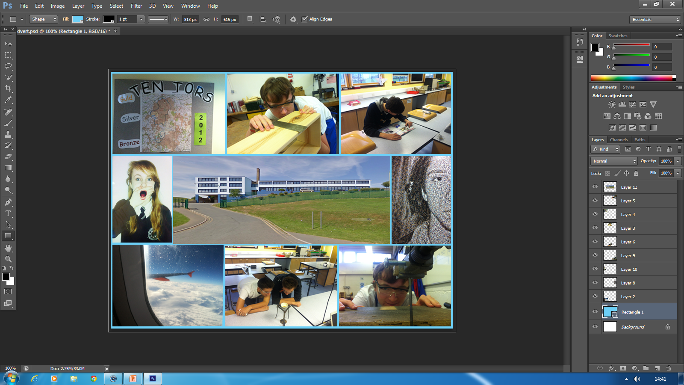
The background of the advert was still white and needed to be changed. To change the background colour I selected the rectangle tool on the left panel. I then selected a colour which was light blue. I then created a large rectangle that covered the whole advert. I then moved the layer to the back so it was the new background.

Slide 7
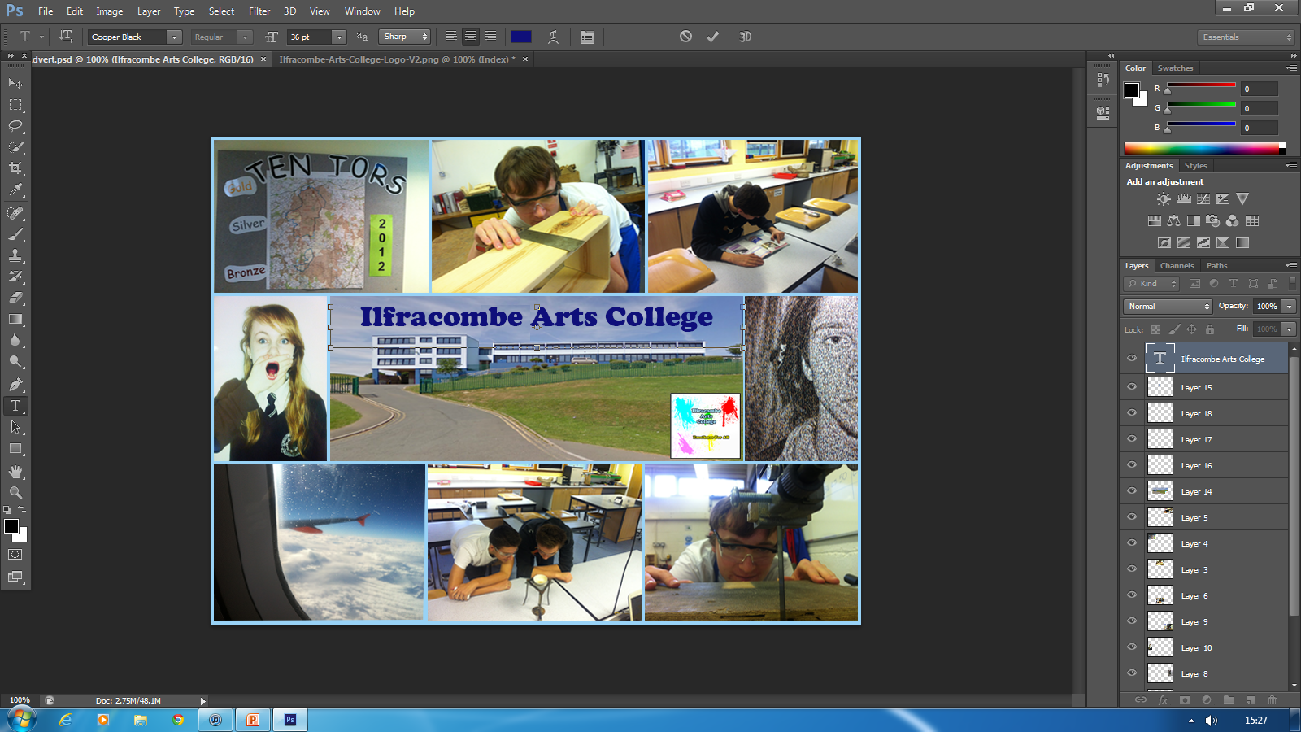
Next was to add the text to do this I selected the text tool and typed Ilfracombe Arts College in the space I created. I then highlighted it and changed the colour to a dark blue. I also added the logo to the design. To do this I followed the same steps as I did at the start with free transforming an image.

Slide 8
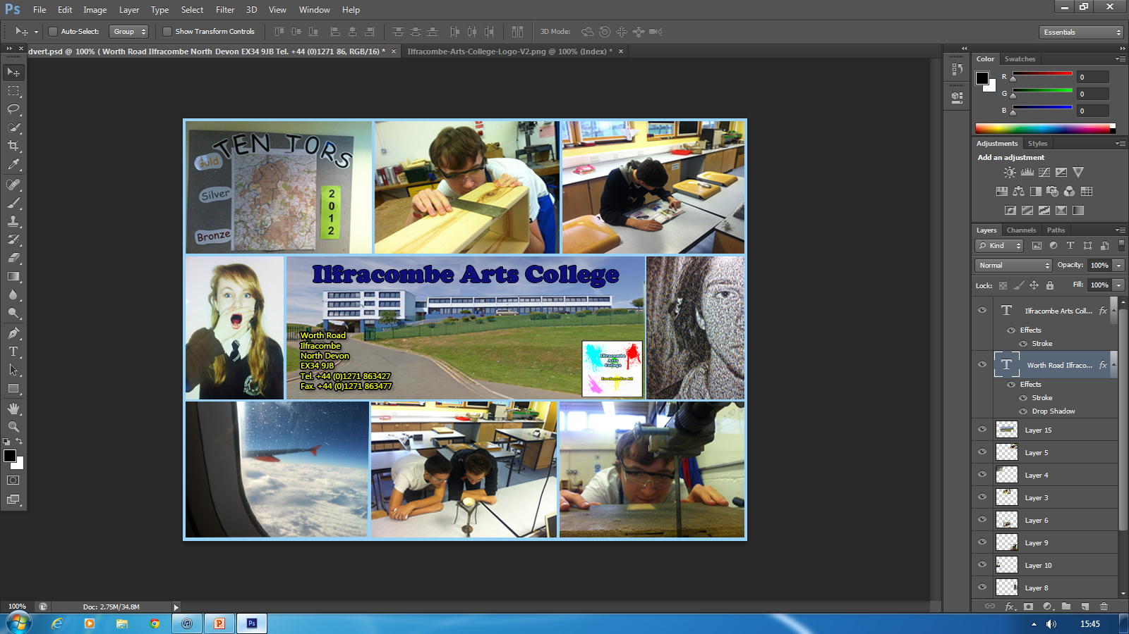
I have now added the second text which is the contact address in a smaller writing, a different style and colour. I then added a stroke effect to both text to make them stand out better. I added a drop shadow effect to both as well to haver the same effect on the text.

Slide 9
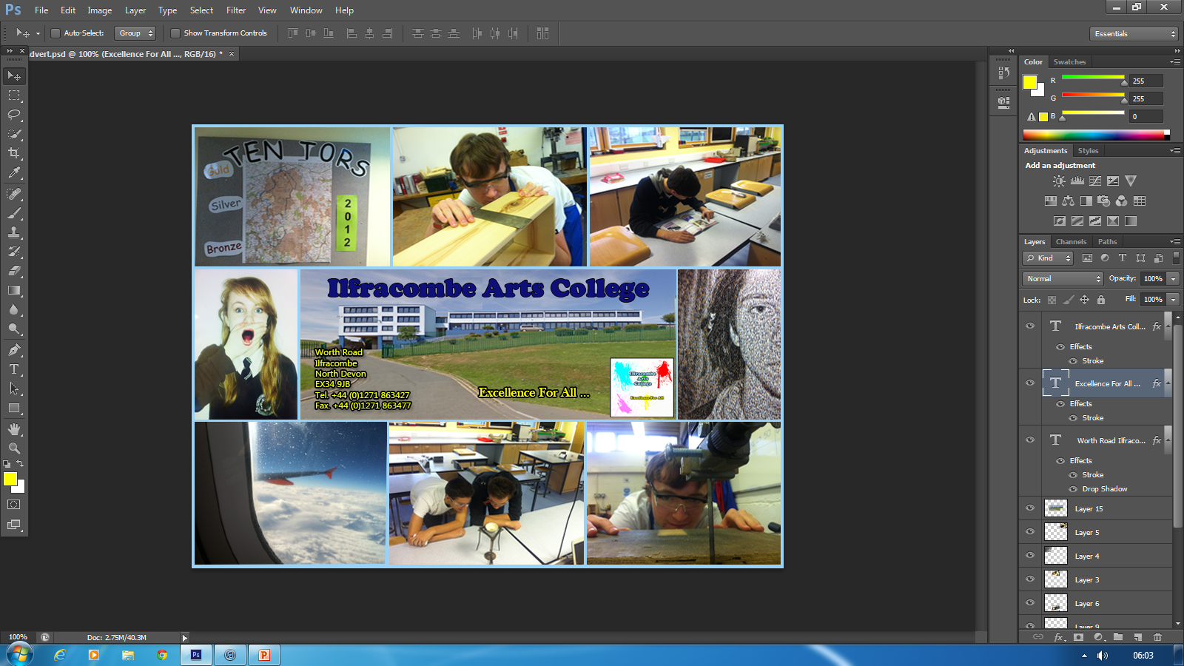
I know have added the final text which is the Colleges slogan. I added the same effect as the address text. To make the slogan more noticeable I just increased the text size and finally positioned it next to the logo.

Slide 10
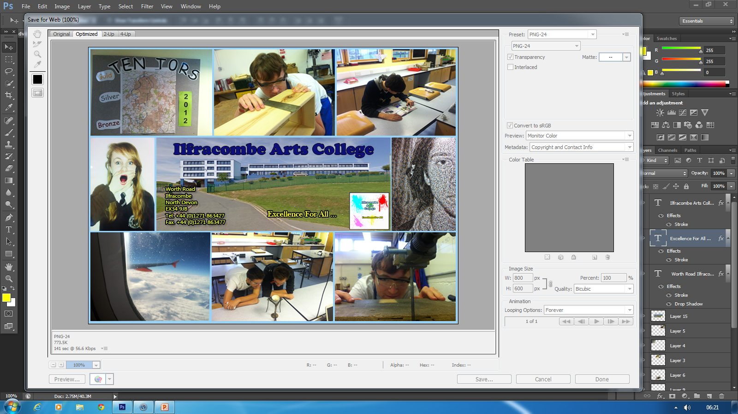
To finalize the logo I clicked file- save for web- and then selected a PNG file, after I specified how I wanted to save I then clicked save. Now the advert was ready for web use I uploaded it to www.surveymonkey.com so I could ask a series of questions to an audience. I then asked 6 people to give feedback the results are shown on the next slide.

Slide 11
Questionnaire Results - I ask a series of different questions to an audience. I asked 6 people to full out a quick 9 question survey on www.surveymonkey.com this was so I could obtain feedback. Here are the questions I asked with the results next to them.
Does this advert appeal to you? 5/6 = Yes
Is the text all easily readable? 3/6 = Yes, 3/6 = The address is to dull.
What improvement could be made? 3/6 = No Improvement, 3/6 = Brighter text.
Do you think the photos used a relevant? 5/6 = Yes
Do you understand what is happening in each image? 5/6 = Yes
Do you think any parts represent the school in a negative way? 5/6 = Yes
Do the pictures represent the school in a successful way? 5/6 = Yes
Would you change any of the pictures used? 5/6 = No
Your overall rating of the advertisement? Average = 8/10
These results showed that most people like the advertisement. Some improvement will be needed to improve the advertisement to its full potential. The most negative question was about the text and many people said it was to dull the address which made it the hardest text to read.

Slide 12
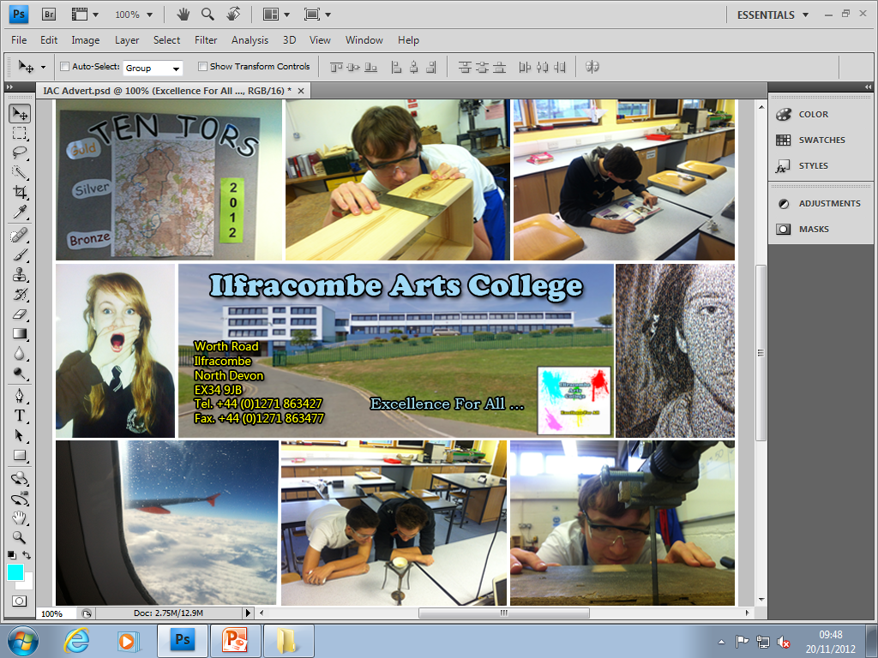
To improve the text I made each text brighter and kept the stroke effect so it still stood out. To improve the address I made the text bigger and brighter. Now when the image was to scale all the text was much more visible and readable. I also added a drop shadow effect to the Ilfracombe Arts College main title. This made it more noticable.

Slide 13
Asking the same question to the same people, all said that the text has had a definite improvement and all of it is easily readable. Comparing both of the advertisement the second is much more readable. I now saved the V2 advert as another PNG file and kept it for further use. Here is V1 and V2 on the next slide.

Slide 14
V2

